Slide 1
Performing a Security Audit of REST APIs and Testing for Vulnerabilities
Darbha Sudha Vaishnavi – AP22110010201
WEB APPLICATION PENETRATION TESTING – CSE 460
SRM University - AP, April 2025

Slide 2
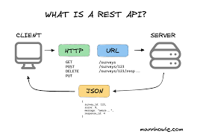
What is REST?
REST: Representational State Transfer – an API design style.
Stateless, uses HTTP methods (GET, POST, PUT, DELETE).
Data in JSON, easy to use and scalable.

Slide 3

Why REST?
Lightweight and fast (uses JSON over HTTP).
Easy to integrate and widely supported.
Easier to test with tools like Postman, Burp.
Compared to SOAP(Simple Object Access Protocol - heavy XML) and GraphQL (query language for APIs - complex), REST is simpler.

Slide 4
Introduction
REST APIs power modern apps but introduce security risks.
Goal: Audit REST APIs using OWASP Juice Shop.
Simulate real-world attacks to identify vulnerabilities.

Slide 5

Problem Statement
Many REST APIs lack security:
- No input validation
- Poor authentication/authorization
Common threats: SQLi, XSS, CSRF, IDOR, Brute Force.

Slide 6

Tools and Technologies Used
1. OWASP Juice Shop – Vulnerable web app for testing.
2. Burp Suite – HTTP proxy and testing tool.

Slide 7
Methodology
1. Setup OWASP Juice Shop on Kali Linux.
2. Configure Burp Suite as proxy.
3. Identify and test API endpoints.
4. Use Repeater and Intruder to simulate attacks.
5. Document findings and confirm vulnerabilities.

Slide 8
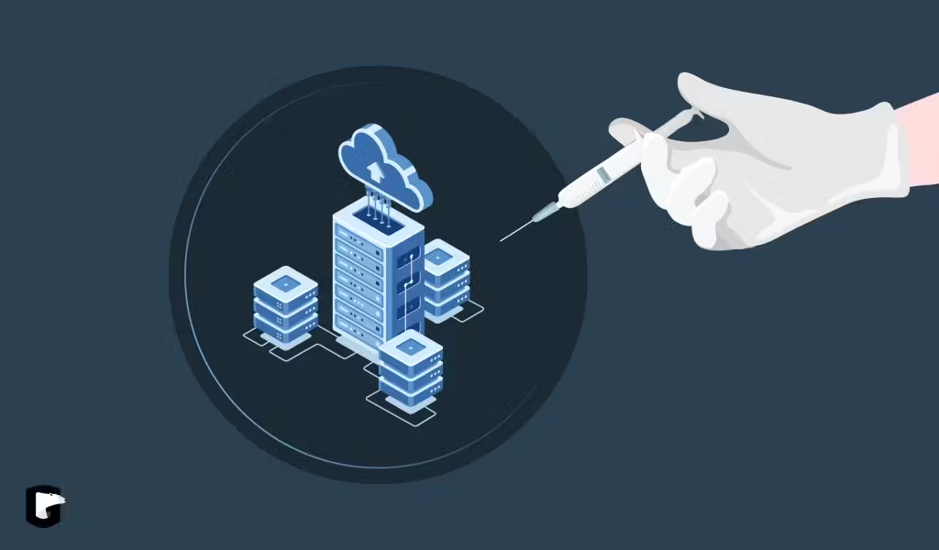
SQL Injection (SQLi)
A technique where attackers insert malicious SQL code into input fields to manipulate or access the database.
Endpoint: /rest/user/login
API Type: POST
Tool: Burp Suite Repeater
Injected SQL payloads to bypass login authentication.

Slide 9
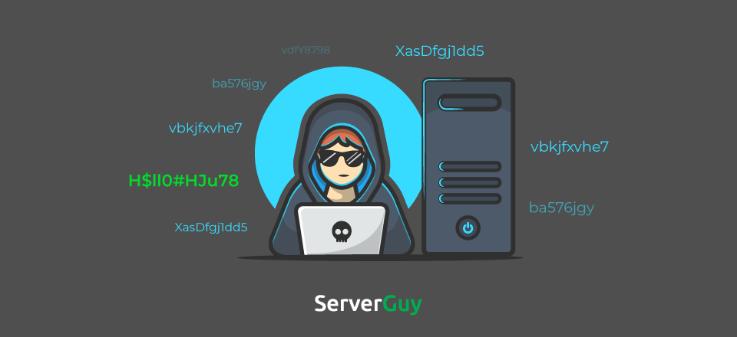
Brute Force Attack
An attack that tries multiple combinations of usernames and passwords to gain unauthorized access.
Endpoint: /rest/user/login
API Type: POST
Tool: Burp Suite Intruder
Automated login attempts to check for lockout mechanisms.

Slide 10
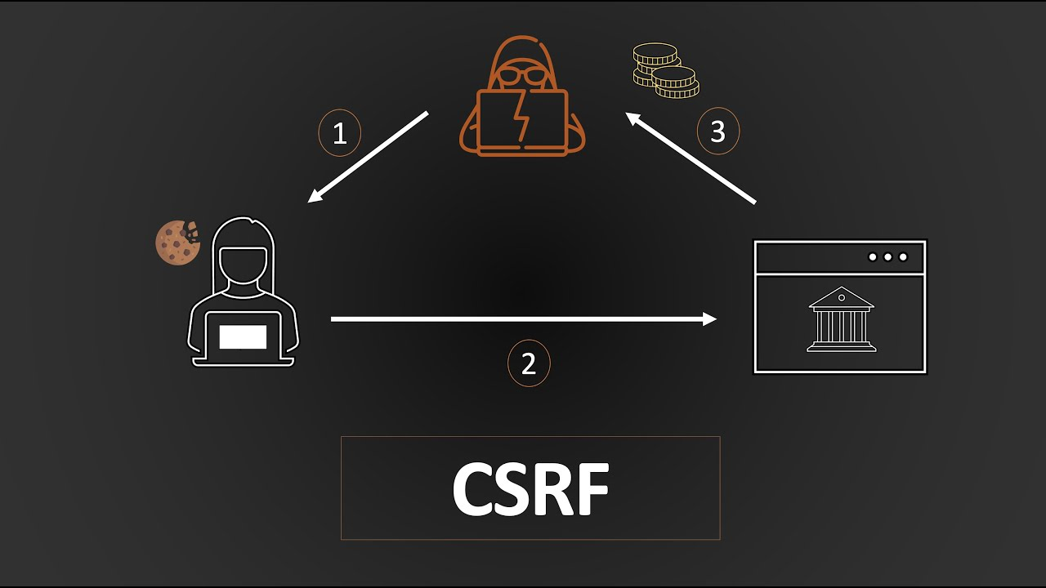
Cross-Site Request Forgery (CSRF)
A trick that forces an authenticated user to perform unwanted actions on a web application without their knowledge.
Endpoint: /api/Feedback
API Type: POST
Tool: Burp Suite Repeater
No CSRF token validation; actions could be forged.

Slide 11
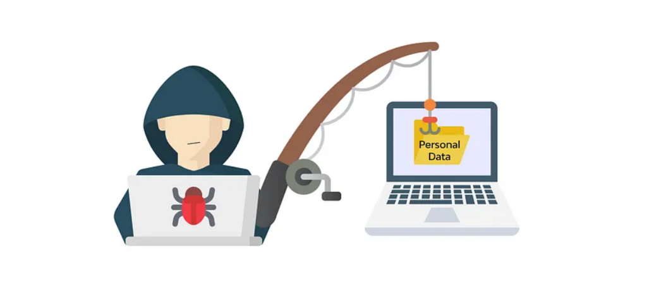
Insecure Direct Object Reference (IDOR)
A flaw where attackers manipulate object identifiers (like user IDs) to access unauthorized data.
A flaw where attackers manipulate object identifiers (like user IDs) to access unauthorized data.
Endpoint: /rest/basket/:id
API Type: GET
Tool: Burp Suite Repeater
Accessed another user’s cart by modifying the ID.

Slide 12

Cross-Site Scripting (XSS)
An attack where malicious scripts are injected into web pages viewed by other users.
An attack where malicious scripts are injected into web pages viewed by other users.
Endpoint: /rest/products/search
API Type: GET
Tool: Browser/Repeater
Injected <img src=x onerror=alert(1)> to run scripts.

Slide 13

JWT Misconfiguration
A weakness in token handling where poor configuration may allow attackers to forge or misuse authentication tokens.
Endpoint: /rest/user/login
API Type: POST
Tool: Burp Suite Decoder
Used HS256 securely. No critical flaw, but consistent 200 responses on tampering.

Slide 14
Vulnerabilities Summary
SQLi: /rest/user/login – DB Access
Brute Force: /rest/user/login – Unauthorized Access
CSRF: /api/Feedback – Forged Actions
IDOR: /rest/basket/:id – Data Exposure
XSS: /rest/products/search – Script Execution
JWT: /rest/user/login – Signature Checked

Slide 15

Impact if Not Solved
Data theft, session hijacking, unauthorized access
Legal consequences, loss of user trust
Breach of GDPR, HIPAA compliance

Slide 16

Mitigation Recommendations
SQLi – Use parameterized queries.
Brute Force – Add rate limiting and CAPTCHA.
CSRF – Implement CSRF tokens.
IDOR – Apply strict access control.
XSS – Sanitize inputs/outputs.
JWT – Validate signatures and use secure algorithms.

Slide 17
Conclusion
Vulnerabilities found: SQLi, XSS, IDOR, CSRF, Brute Force.
Tools used: Juice Shop, Burp Suite.
Emphasized secure coding and token validation.
Project demonstrates need for secure API design.

